Slide 1
SUU DEI
File created on: 9/6/2021 12:34:50 PM

Slide 2
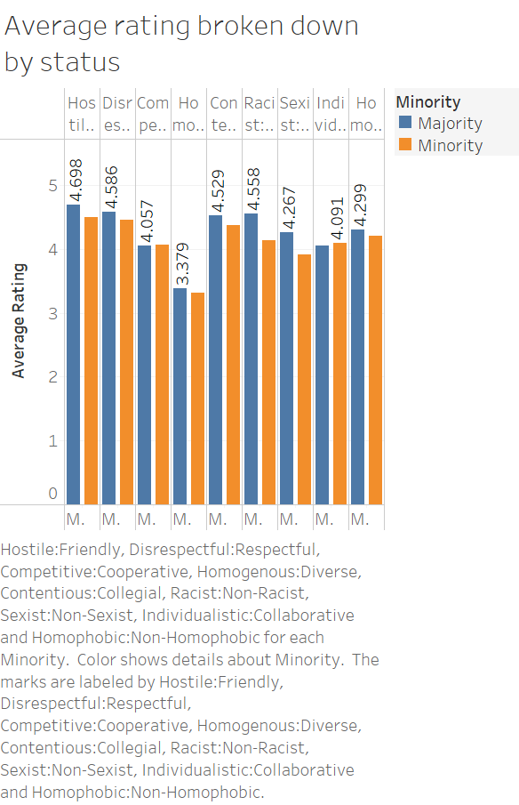

Slide 3
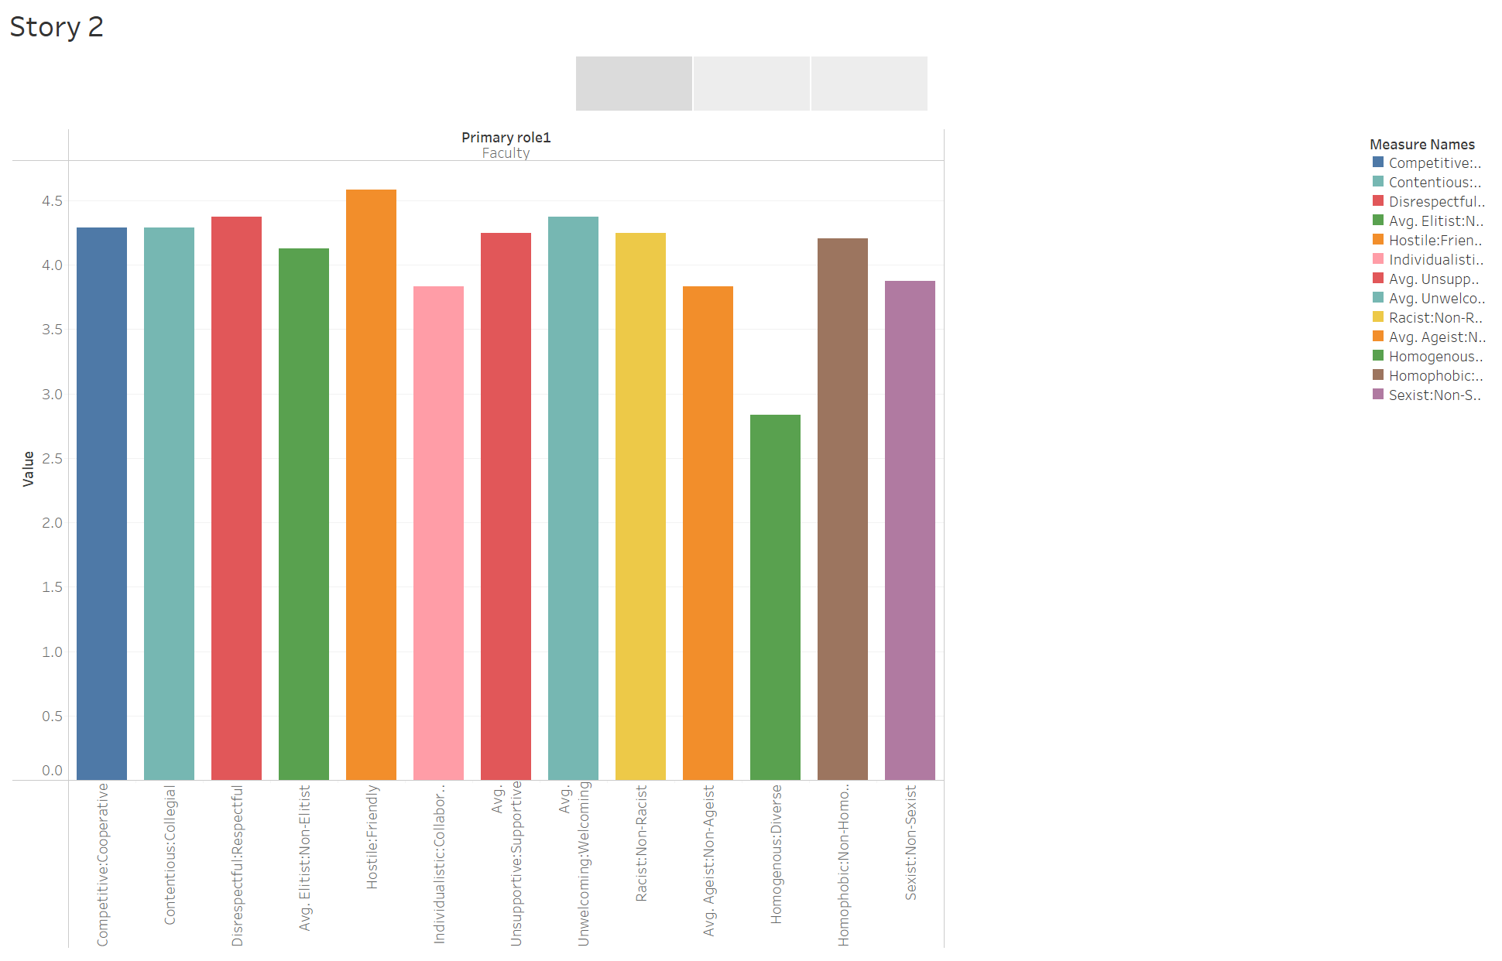

Slide 4
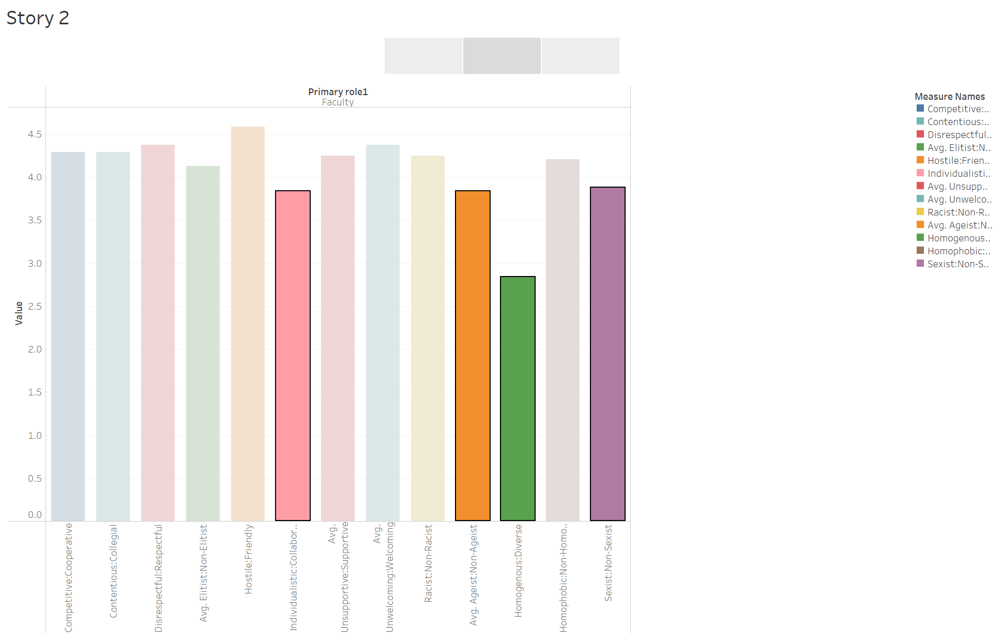

Slide 5
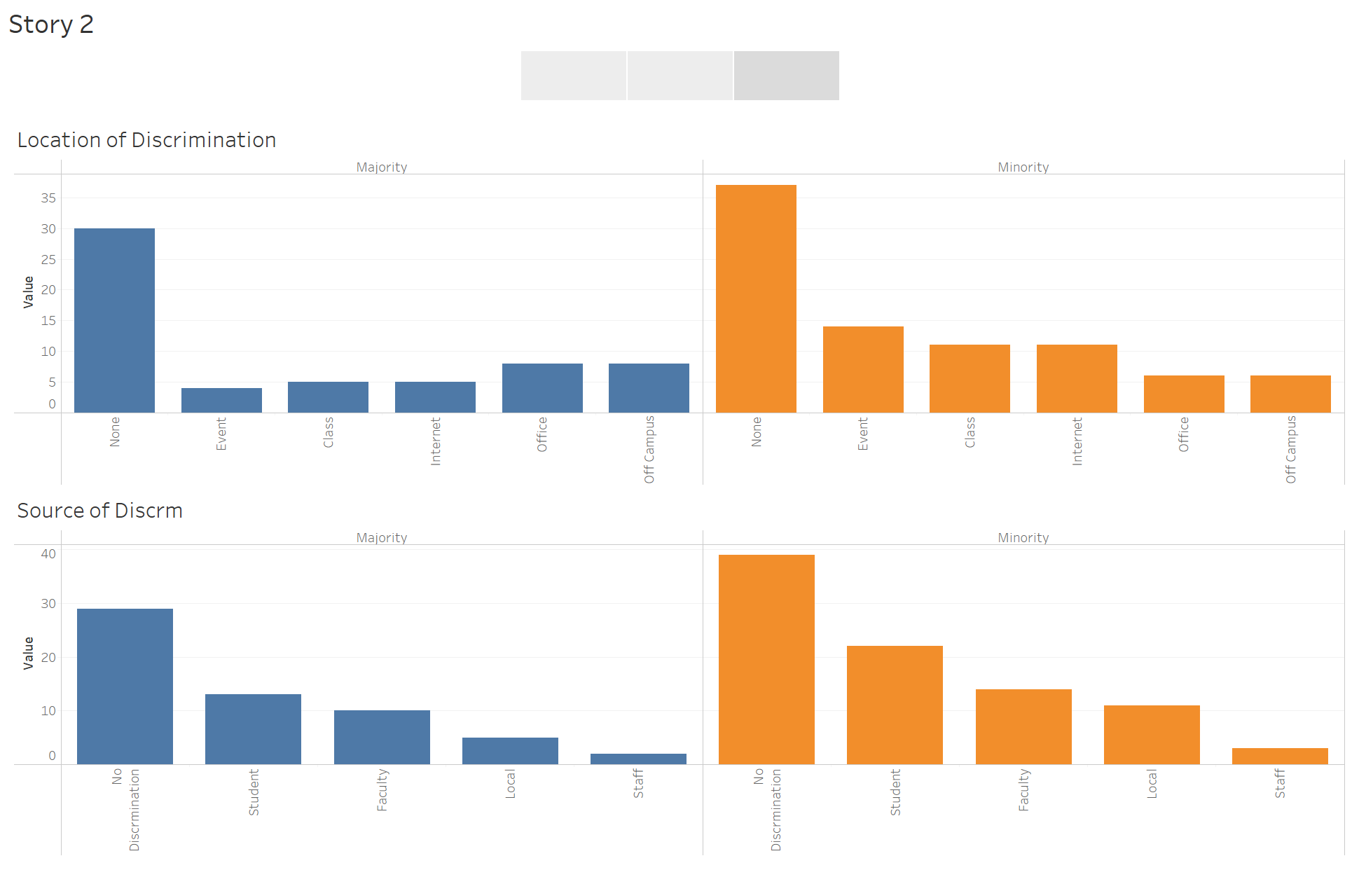

Slide 6
